Slide 1
Analysis of Kickstarter Projects
Fahim Istiak - 2407699
Mohammad Rakibur Rahman - 2410695
Mazidul Islam - 2503039

Slide 2
Project Description
Objective: Predict Kickstarter project success or failure using machine learning.
Dataset: 377,364 Kickstarter projects across categories (art, music, tech, etc.).
Task: Binary classification — predict successful or failed.
Notes:
We explored key variables like state, category, and country. Most projects are either successful or failed, with the US being the top contributor. The dataset showed clear trends we could build on.

Slide 3
Related Work
Li et al. (2017) emphasized the use of NLP on campaign descriptions and found Random Forest and SVM effective for predicting success.
Xie et al. (2018) used Kickstarter and Indiegogo data, highlighting campaign category, duration, and initial funding speed as strong predictors.
Agerri et al. (2017) applied ensemble methods like Boosted Trees and emphasized the value of feature engineering.
Li & Lee (2016) showed that language in project descriptions was a strong predictor and used SVM and logistic regression.
Park et al. (2020) presented a meta-analysis identifying key success factors: goal size, backer engagement, and category.
Liu et al. (2018) introduced social media sentiment from Twitter as an external predictor.

Slide 4
Data

Slide 5
Data Exploration
Overview of Dataset:
Explored key categorical variables: state, main_category, category, currency, country.
Found distinct counts: 159 categories, 15 main categories, 14 currencies, 22 countries.
Understanding State Outcomes:
5 possible project states: failed, successful, canceled, suspended, live.
Failed and Successful projects make up ~88% of the data.
Distribution Analysis:
Most projects are from the US.
State-wise: Majority of projects are either failed or successful

Slide 6
Data Cleansing
Kept only projects with valid states (failed and successful).
Removed invalid/malformed entries from main_category and country.
Dropped projects with a fundraising goal of $0.
Data Type Corrections: Cast numerical columns (fundraising_goal, fundraising_pledged, backers) to appropriate types.
Checked and confirmed no missing values after cleaning.
Dropped any duplicate rows to ensure uniqueness.
Removed outliers in fundraising_goal and backers using Interquartile Range (IQR) method.
Trimmed whitespaces and converted values to uppercase for consistency.

Slide 7
Feature Engineering
01 : Selected relevant features from the dataset for model input.
02 : Categorical encoding: Converted categorical variables (category, main_category, currency, country) into numeric using ‘StringIndexer’.
03: Created feature vectors using ‘VectorAssembler’ to combine numeric and encoded features.
04 : Target encoding: Converted the target column status into a numeric label using ‘StringIndexer’.
05 : Correlation analysis: Performed pairwise correlation among numeric features to understand relationships.

Slide 8
Dataset Summary
Final dataset has 219052 rows.
11 cleaned and engineered columns.
Ready for Modeling
Cleaned, consistent, and reliable dataset for further analysis or model building

Slide 9
Analysis

Slide 10
Exploratory Data Analysis
Variable | Mean, SD Min-Max
Days Allotted | 33.42, 12.88 1 – 92
Fundraising Goal (USD) | 5,871.67, 6,104.14 1.00 – 27,000.00
Fundraising Pledged (USD) | 2,340.04, 3,956.52 0 – 206,751
Completion Percentage (%) | 184.15, 6,403.14 0 – 1,506,600
Number of Backers | 29.87, 33.81 1 – 140

Slide 11
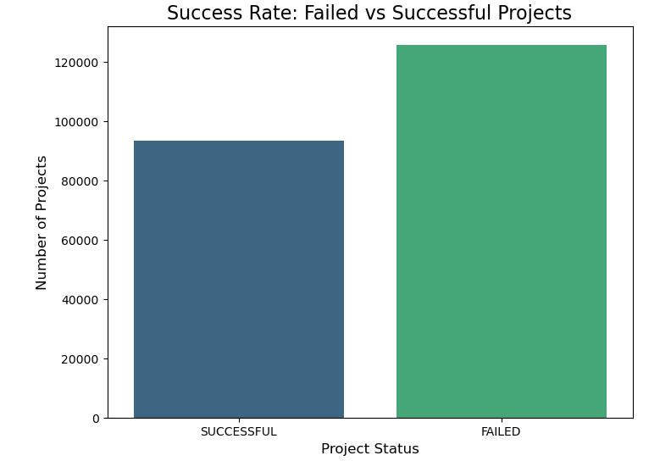
Success Rate (Failed vs Successful Projects)
125,669 failed projects
93,383 successful projects
The number of failed projects is significantly higher than the successful ones.

Slide 12
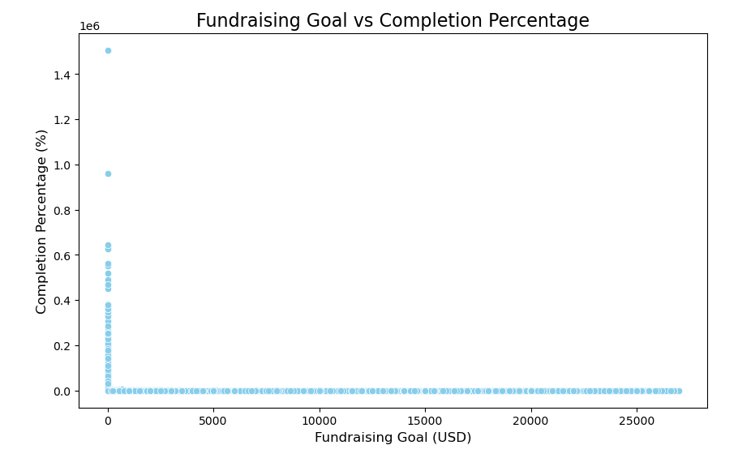
Fundraising Goal vs Completion Percentage
The correlation is 0.02, indicating a very weak negative correlation.

Slide 13
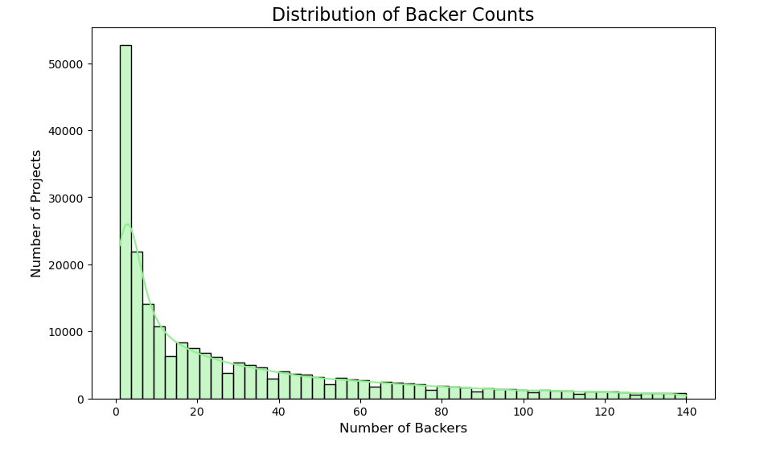
Distribution of Backer Counts
Key Observations:
Concentration of Projects with Low backers
Exponential Decline
Highly Skewed Distribution
Long Tail
Possible Insights:
Backer Count as a Success Indicator
Focus on Smaller Backer Project
Outliers
Recommendations:
Targeting Small Backer Projects
Analyzing High Backer Projects

Slide 14
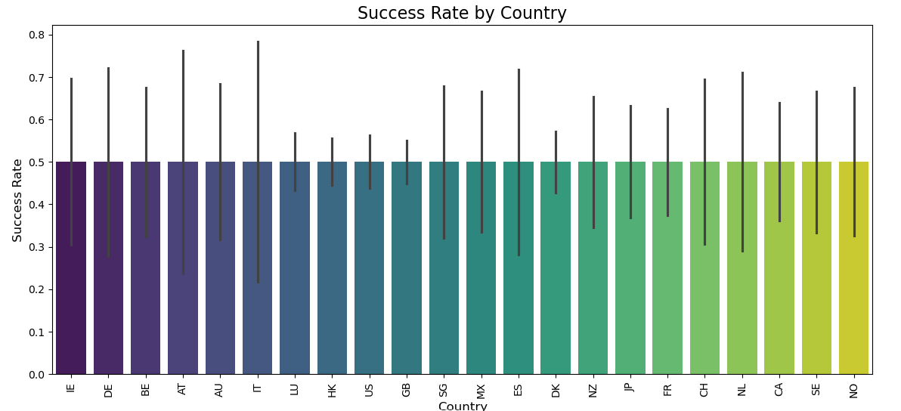
Success rate by country
Trend:
Similar Success Rates Across Countries
High Success Rate Countries :
IE (Ireland),
DE (Germany)
BE (Belgium)
Low Success Rates Countries :
Norway
Sweden

Slide 15
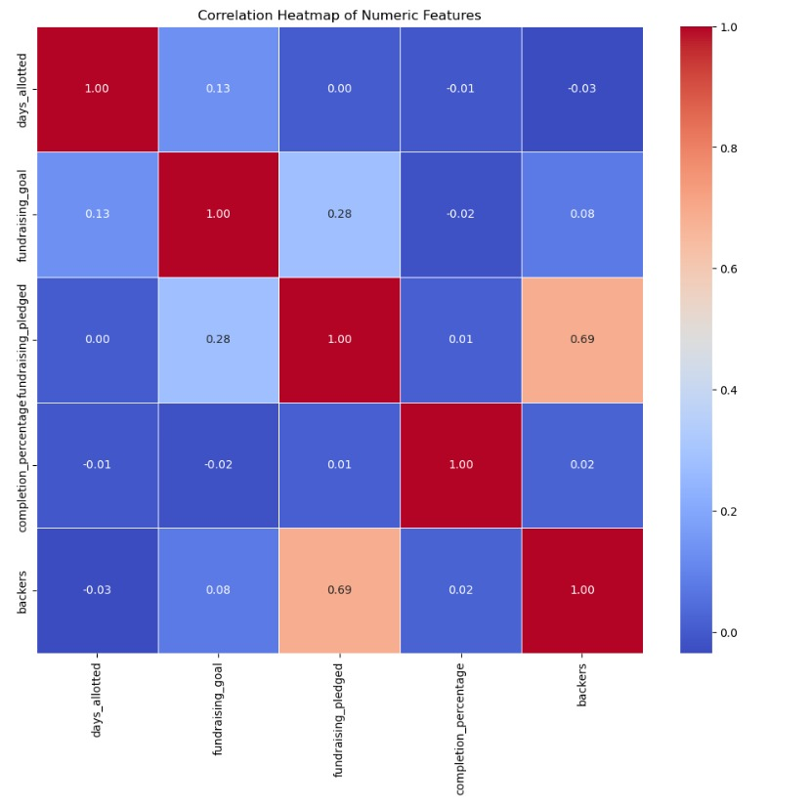
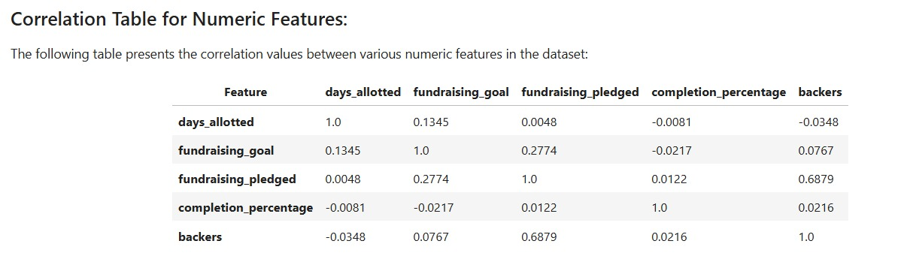
Correlation of Numeric Feature

Slide 16
Model Building
Model Used:
Alternative Classifier:
Libraries Used:
Logistic Regression (primary classifier).
Random Forest Classifier
pyspark.ml.classification for LogisticRegression, RandomForestClassifier
pyspark.ml.feature for StringIndexer, VectorAssembler
pyspark.ml.tuning for cross-validation and hyperparameter tuning

Slide 17
Model Evaluation
Train-Test Split:
Evaluation Metrics:
Cross-Validation
80% training
20% testing.
ROC AUC Score: Evaluates the model's ability to distinguish between classes.
Accuracy: Assesses overall prediction correctness.
3-fold cross-validation used with a parameter grid to tune regParam and maxIter for logistic regression.

Slide 18
Model Random forest evaluation
ROC AUC Score : 0.99986
Accuracy : 0.99984

Slide 19
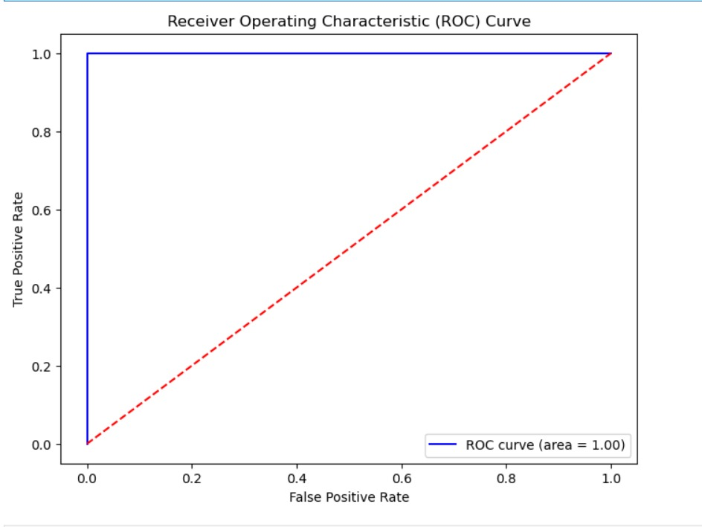
Model Logistic regression evaluation
ROC AUC score for Logistic regression: 0.99997
Accuracy for Logistic regression: 0.999977

Slide 20
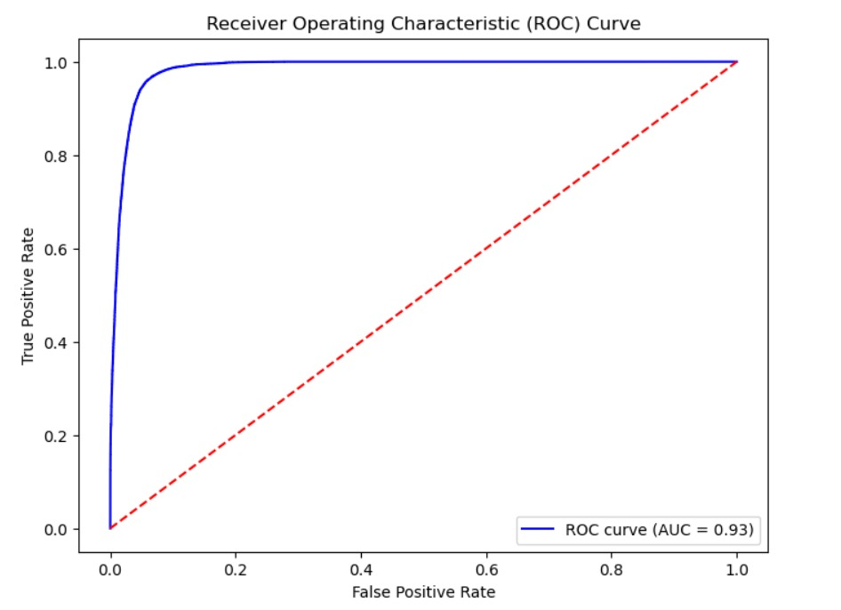
Model Logistic regression evaluation
ROC AUC score after 5-fold cross-validation: 0.9398612927515554
Accuracy after 5-fold cross-validation: 0.9398397472585334
ROC AUC score after regularization: 0.9178612927515554
Accuracy after regularization: 0.9178397472585334

Slide 21
Discussion and Limitations
Why did Logistic Regression perform well?
✅ Clean, high-quality structured data
✅ Strong signals from features like goal, backers, and duration
✅ Balanced binary outcome (Success vs Failed)
Limitations to note
️ Ignored rich text features (e.g., project descriptions)
️ No analysis of Twitter/social media signals
️ Limited comparison with other models (e.g., Gradient Boosting, XGBoost)

Slide 22
Conclusion & Future Work
Key Outcomes
Developed a highly accurate Kickstarter classifier using PySpark + Logistic Regression and Random Forest
Achieved ROC AUC & Accuracy ≈ 93%, outperforming previous studies
Showed that structured features alone can be highly predictive with proper preprocessing
Future Improvements
Apply NLP to analyze project descriptions
Incorporate social media signals (e.g., tweet sentiment)
Explore ensemble models like XGBoost or Random Forest
Takeaway
Simple models + smart feature engineering + scalable tools = big impact

Slide 23
References
1. Li, A., Shun, K., et al. (2017). Predicting Success in Crowdfunding Campaigns.
2. Xie, Y., Lu, Y., et al. (2018). Data-Driven Analysis of Crowdfunding Campaign Success and Failure.
3. Agerri, D., Garcia-Gomez, M., et al. (2017). Success of Crowdfunding Campaigns: A Machine Learning Approach.
4. Li, Z., Lee, L., et al. (2016). Empirical Study of Predicting Success in Crowdfunding Projects.
5. Park, H. S., Kim, J. G., et al. (2020). A Meta-Analysis of Factors Influencing Crowdfunding Success.
6. Liu, B. R., Liu, F., et al. (2018). Social Media Predictive Power for Crowdfunding Success.
7. Kickstarter Dataset, Kaggle. https://www.kaggle.com/datasets/kemical/kickstarter-projects
8. PySpark Documentation. https://spark.apache.org/docs/latest/api/python/index.html

Slide 24
Thank you
Any questions?

